Slide 1


Initial User Interface Designs - Mendix
App Name
Sign In
Username
Password
Login
Register
Forgotten Password?

Slide 2

Home
New Customer
Existing Customer

Slide 3


Password Reset
In order to reset your password please enter your username or email address used to login and press submit
Username or Password
Submit

Slide 4
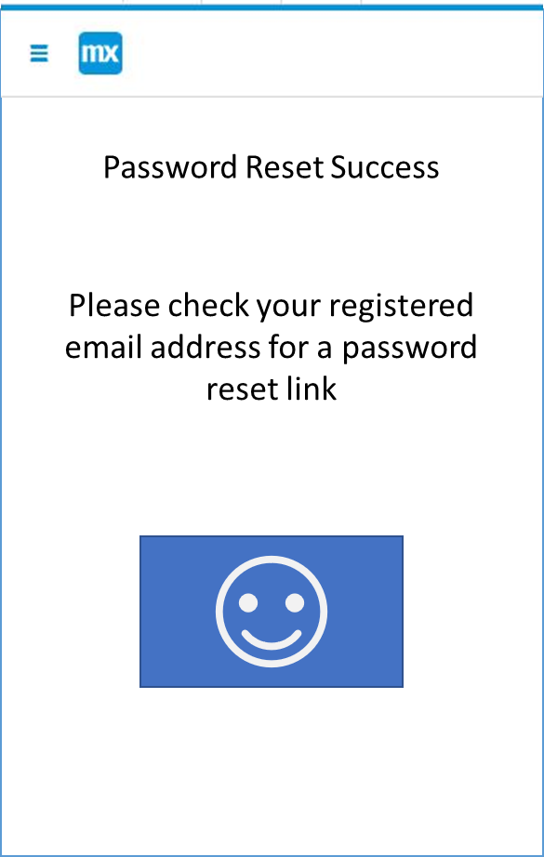




Password Reset Success
Password Reset Failure
Please check your registered email address for a password reset link
Please check the username or email address entered
Home
Back

Slide 5

Registration
Username
Password
Email
Register

Slide 6
New Customer
First Name
Surname
Phone No
Email
Save

Slide 7

Customers
Joe Bloggs
Dave Lee
Bob Davis

Slide 8
Customer Details
Joe Bloggs
01227123456
email@email.com
Edit
Property's

Slide 9
Property Details
1 Millfield Manor
2 Swanfield Road
5 Canterbury Road
Add New

Slide 10

New Property Details
Property Type
Number of Bedrooms
Number of Bathrooms
Next

Slide 11

Garden
Garage
Parking
Next

Slide 12
Device Camera Image
Room Name
Room Description
Save
Next

